Slide 1


SMK NEGERI 1 SURADE PROFILE
DINAS PENDIDIKAN PROVINSI JAWA BARAT 2019
Presented by H. Awan Sudianto, SP.,MP

Slide 2
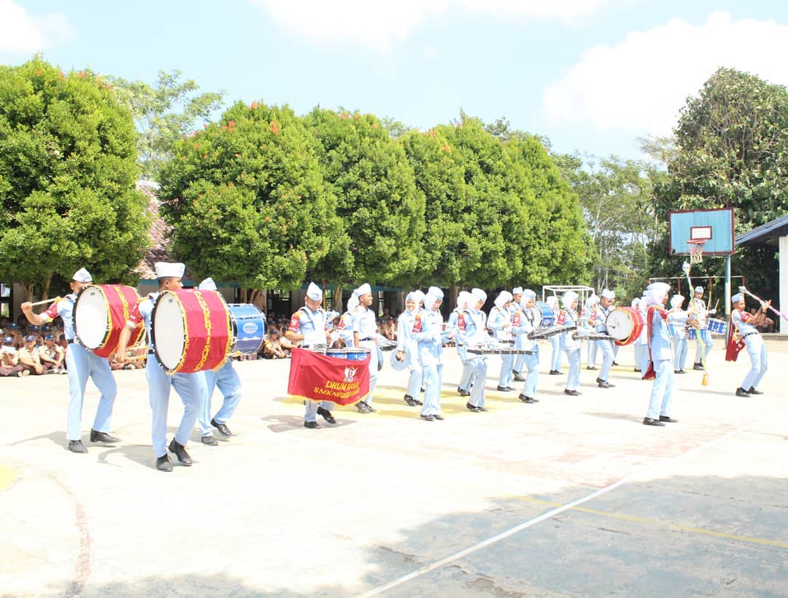
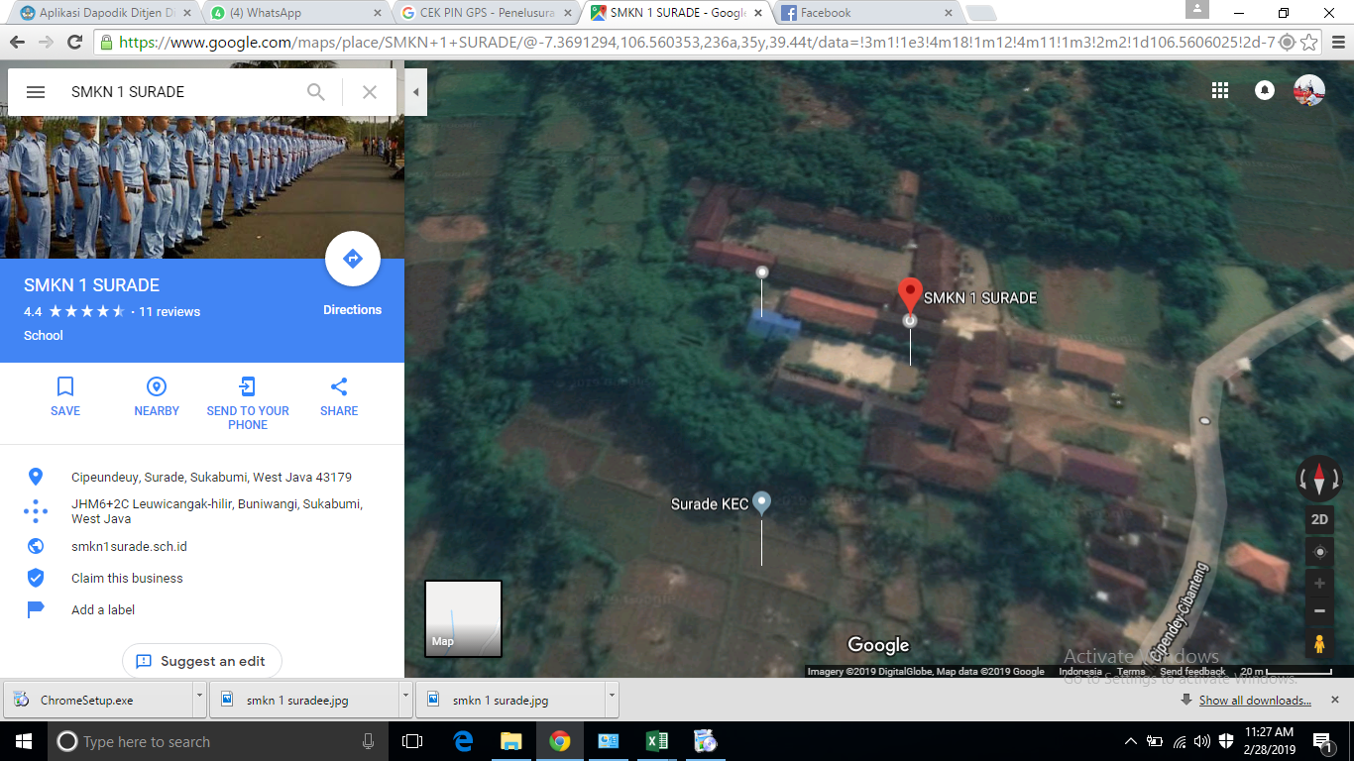
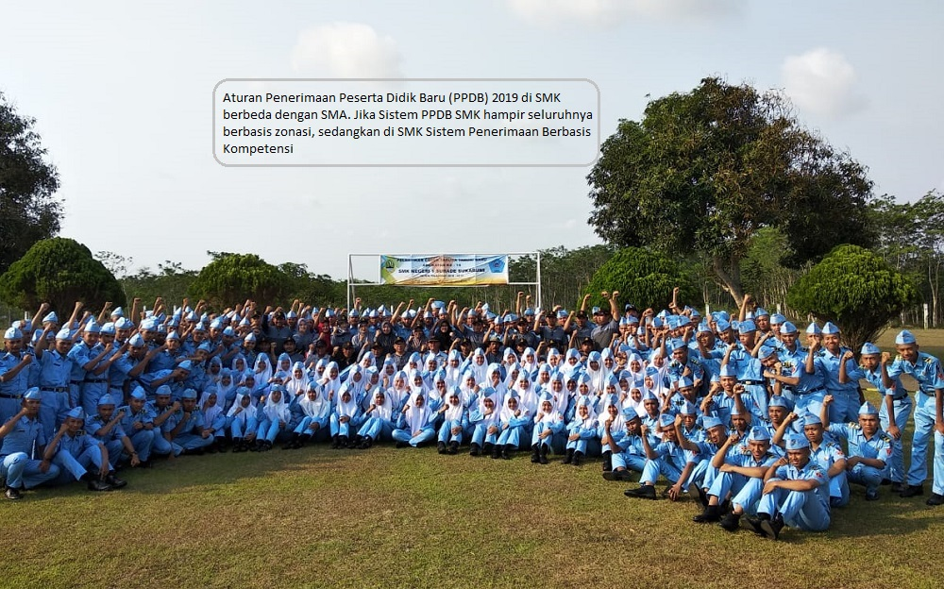
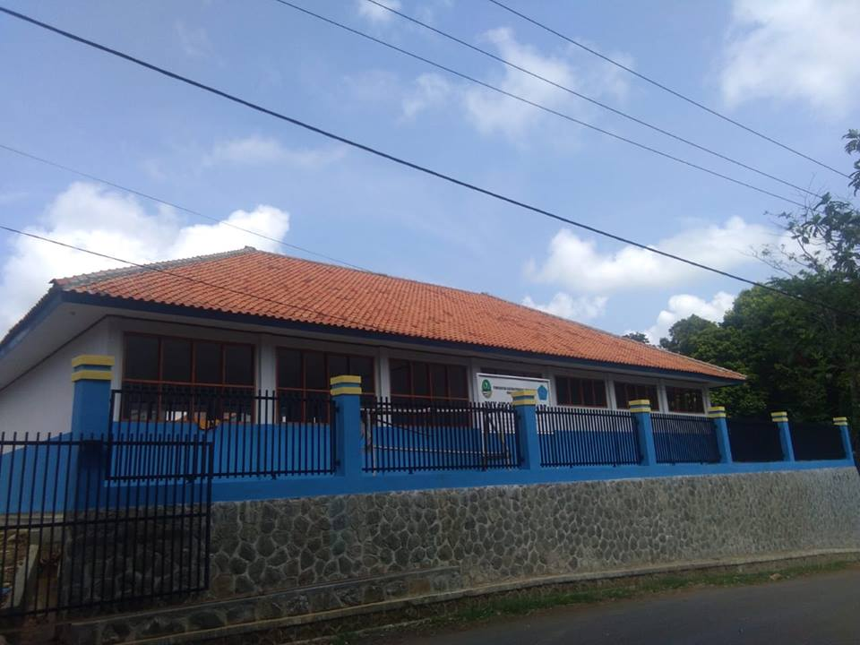
LOCATION

Slide 3
VISION AND MISION
VISION
Creating a Vocational Education Institution that is superior, characterized and Competitive.
MISION
Preparing the student to able in choosing carrier, competitive, independence, tenacious as a professional middle worker.
Embedding the culture values and nation character.
Completing educational facilities infrastructure.
Realizing democratic management, transparent and accountability.
Creating a healthy school condition, dynamic, based on faith, devotion and noble character.
Developing a comfortable work environment based on togetherness, kinship and exemplary attitude.

Slide 4
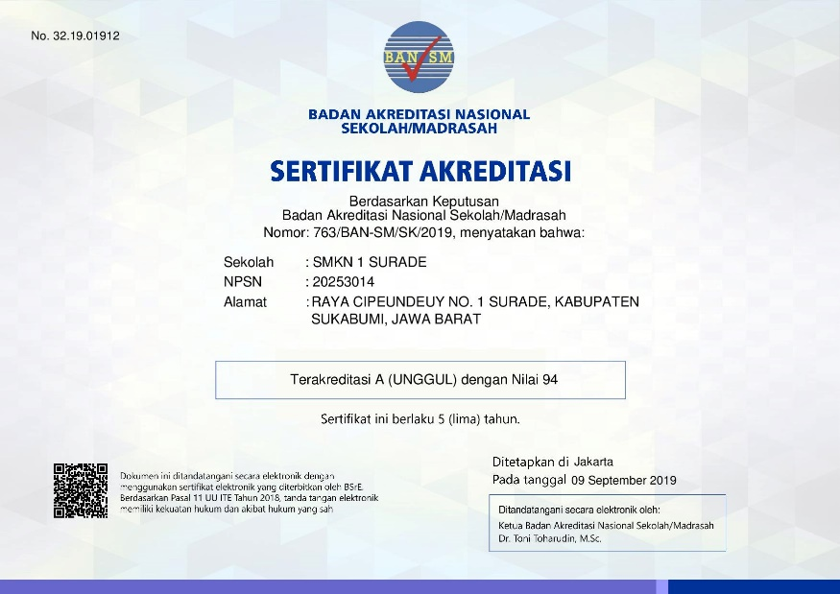

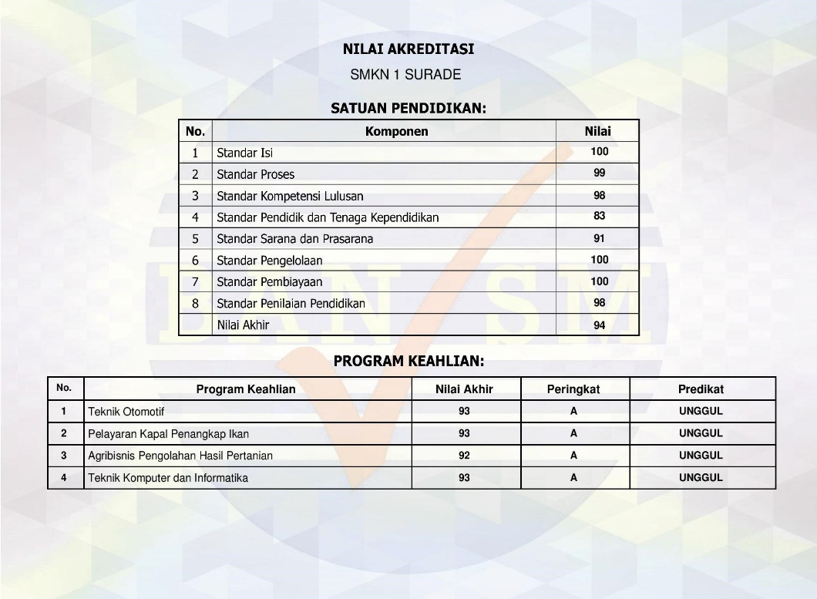



STUDY PROGRAM
Nautical Fishing Vessel (NKPI)
Agricultural Product Processing Agribusiness (APHP)
Automotif (TKRO)
Multimedia

Slide 5
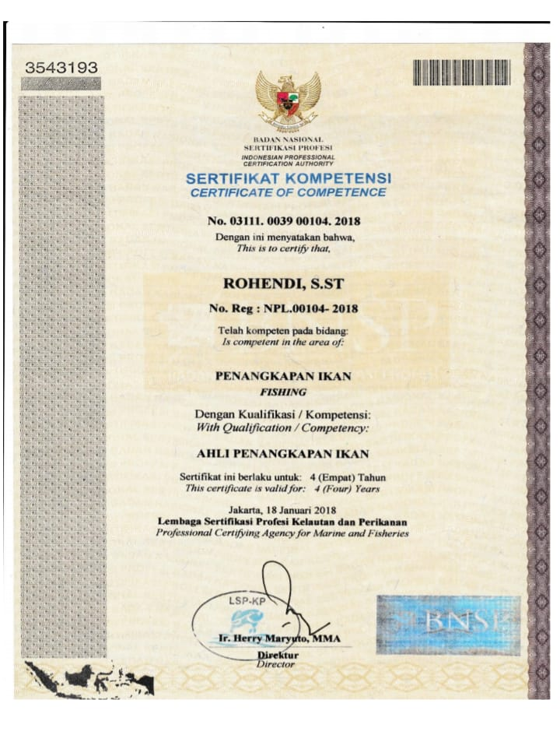
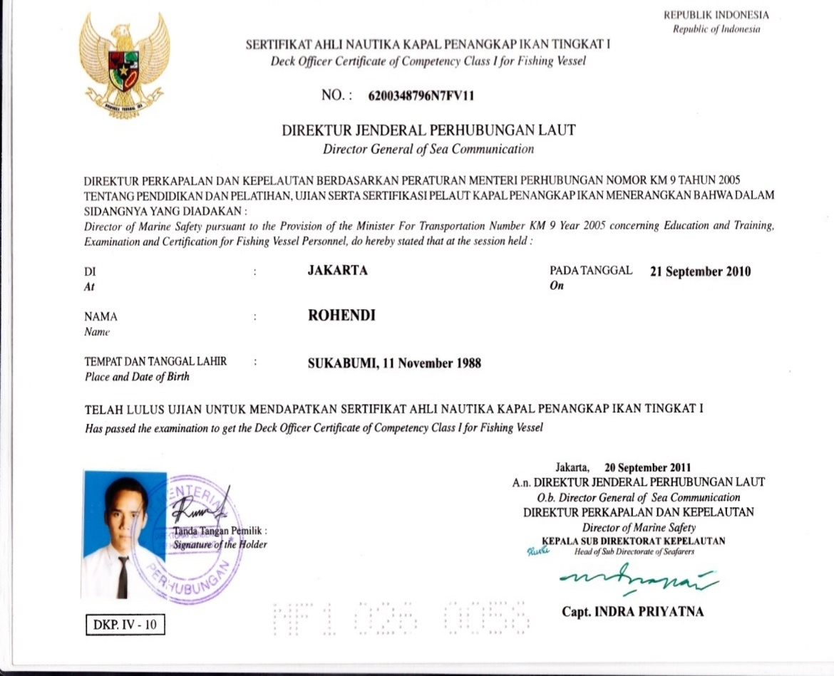
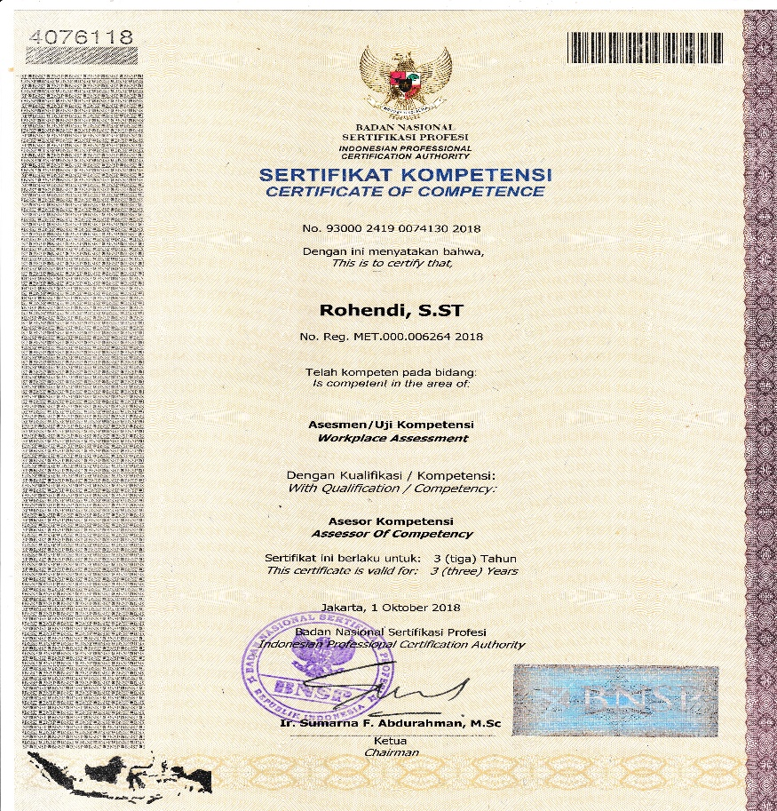
HUMAN RESOURCES EXPERTISE
Nautical Fishing Boat Expert (ANKAPIN 1) : 1
Certificate Of Proficiency (SKK) 60 Miles : 1
Technical Certificate : 2
Certificate Of Assesor : 2

Slide 6
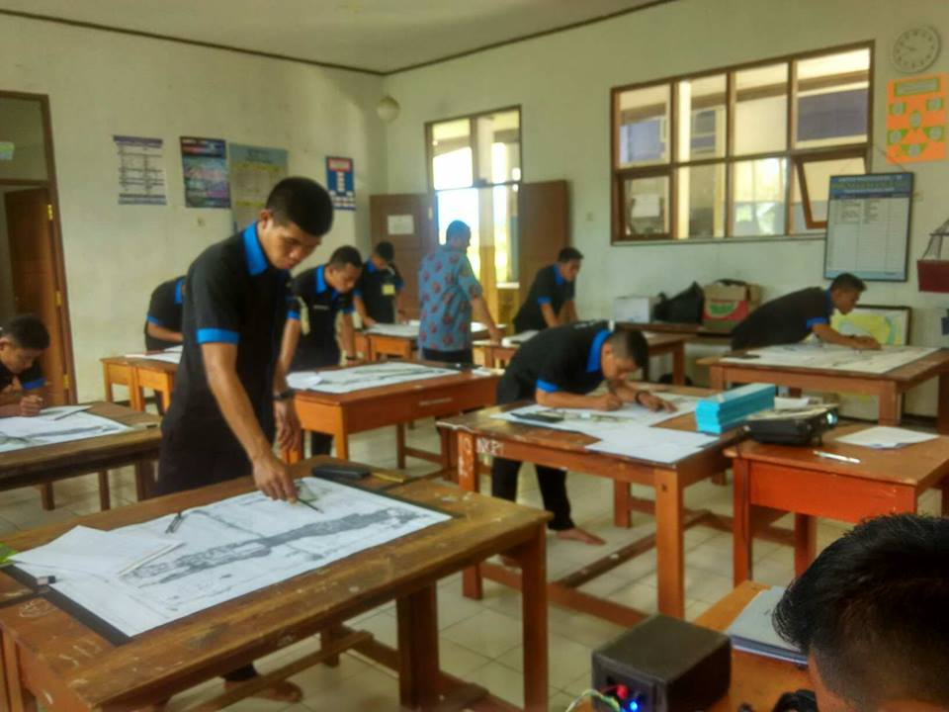
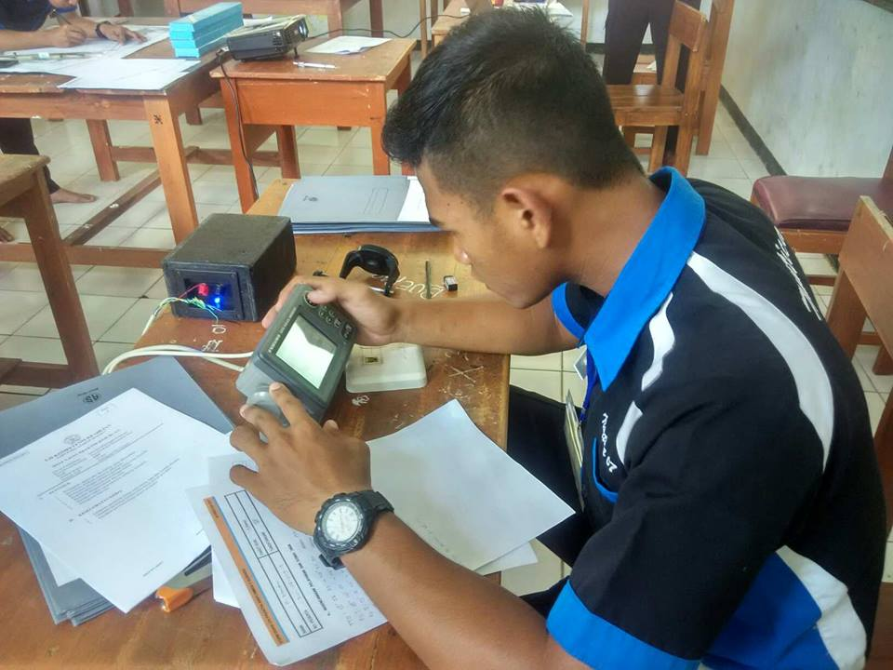
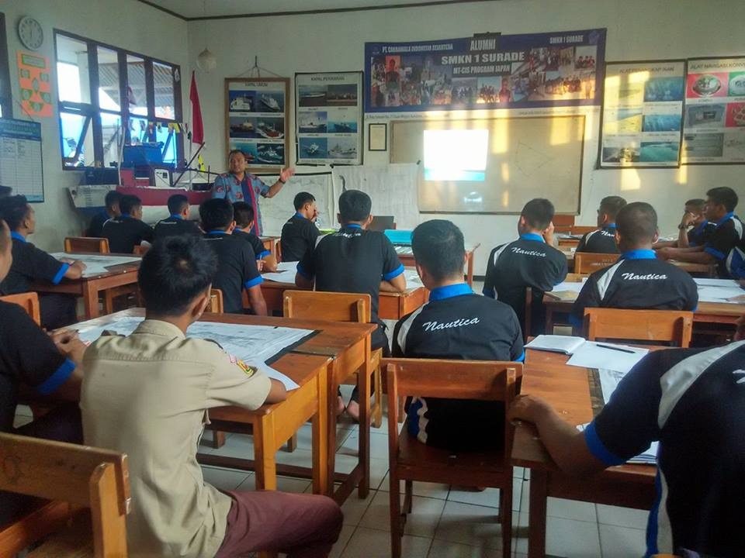
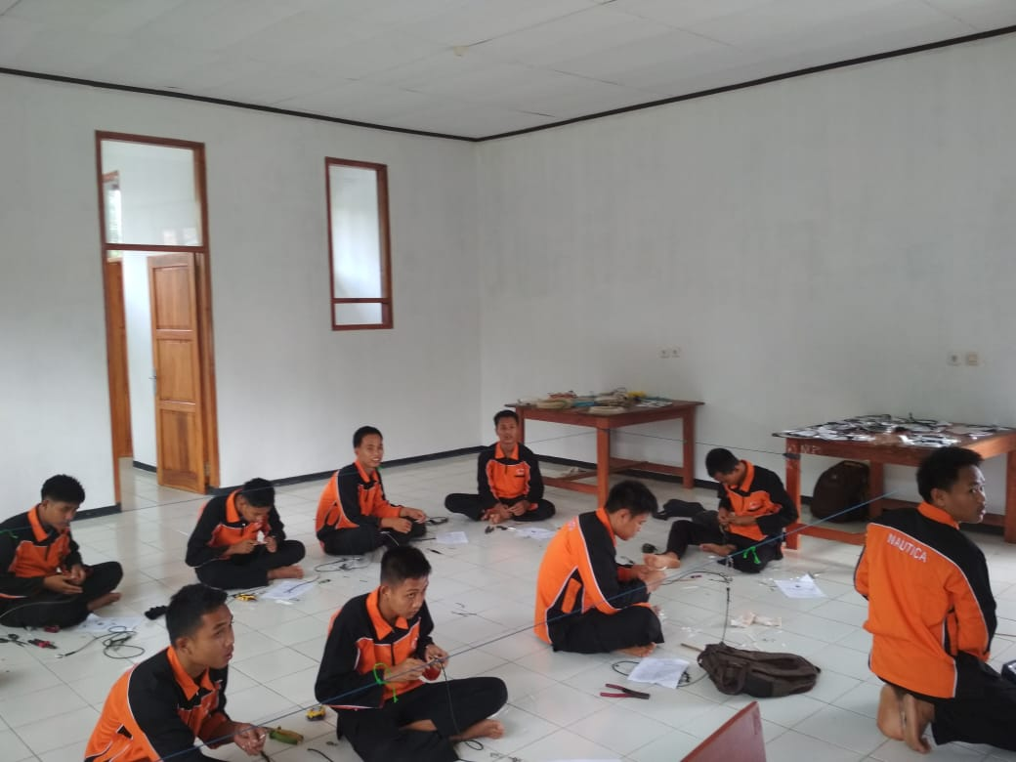
PRACTICE LABORATORY

Slide 7
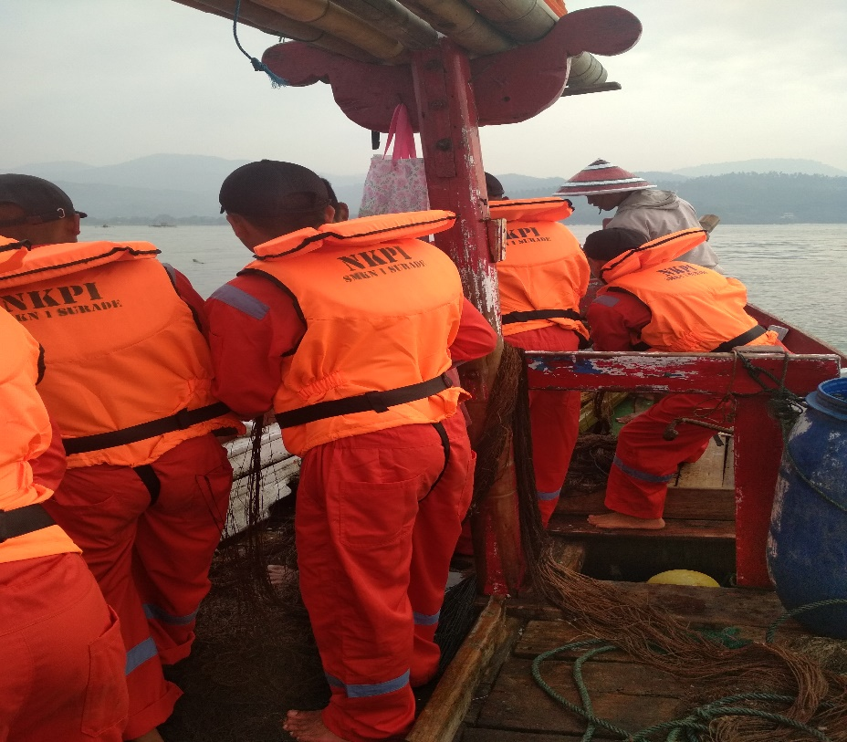
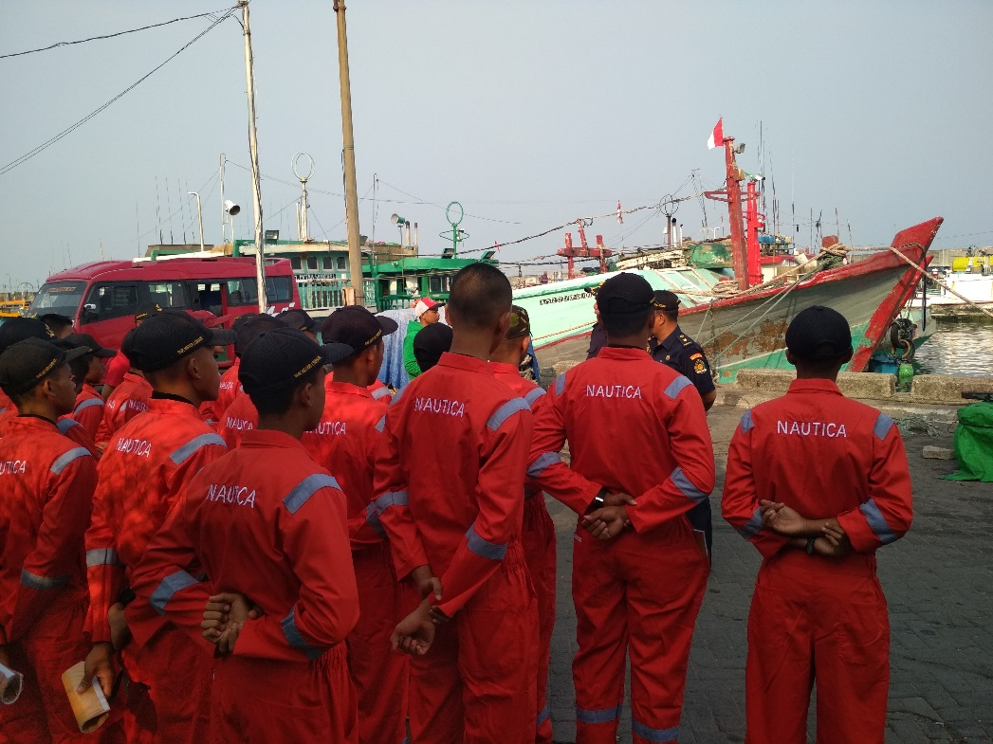
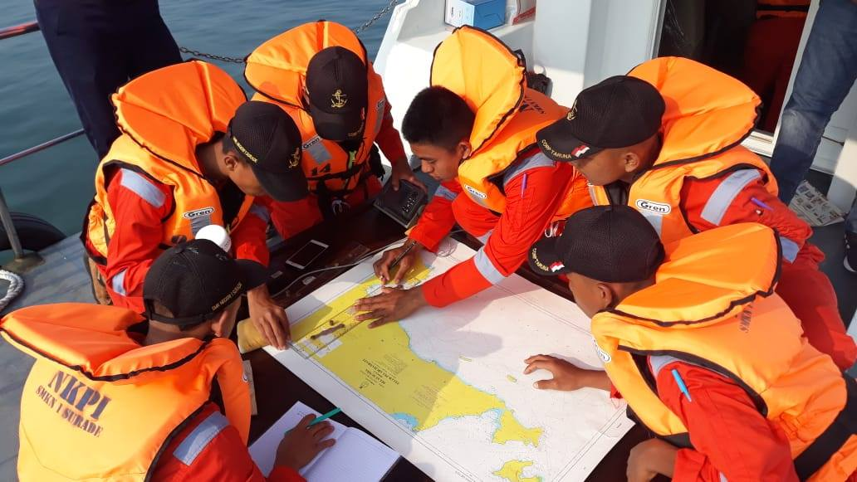
FISHING TRIP

Slide 8
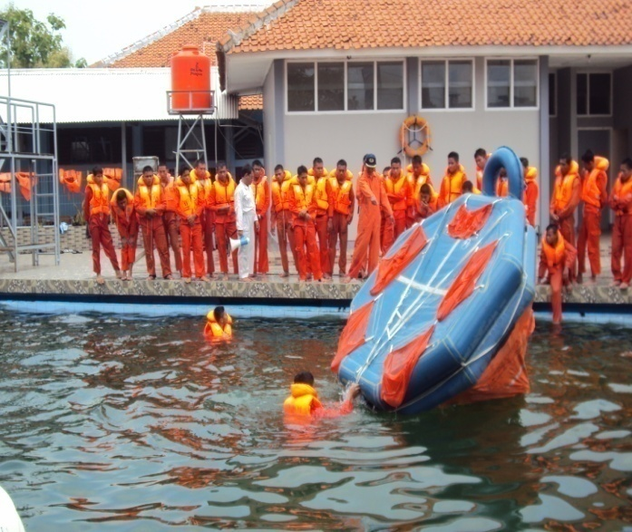
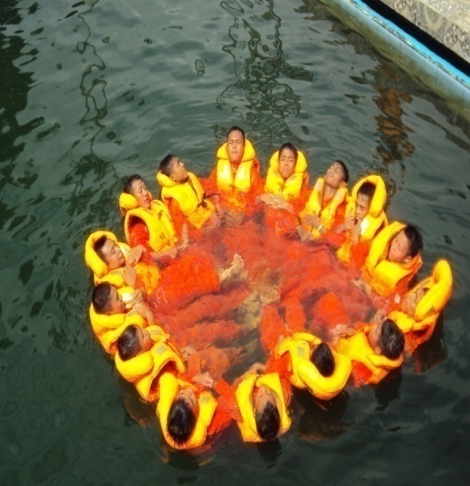
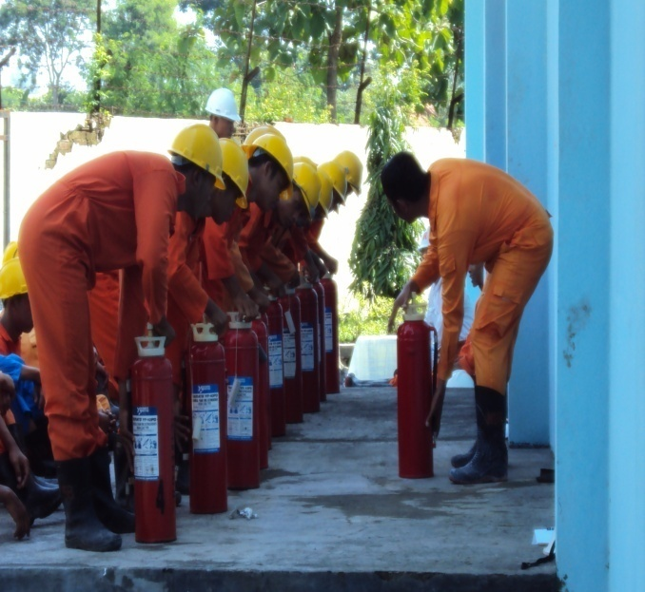
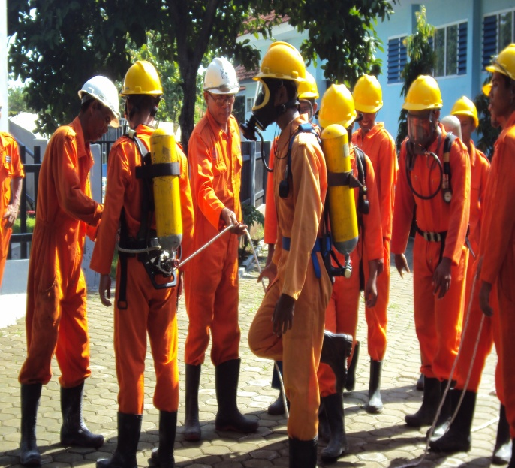
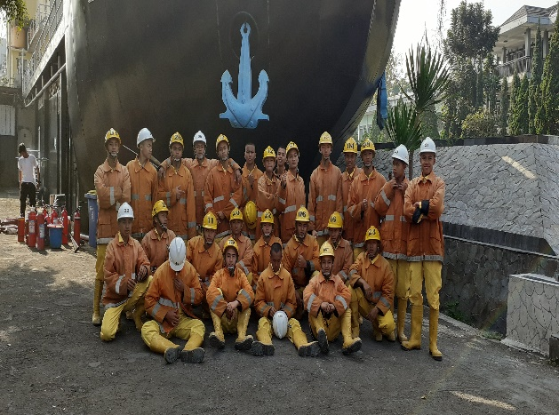
STANDART TRAINING FOR SEAFERES

Slide 9
PARTNER INSTITUTION/INDUSTRY
PT. CAKRAWALA INDONESIA SEJAHTERA
PT. AISYAH MUTIARA SAMUDERA
PT. KHARISMA ABADI SAMUDERA
G TO G JAPAN
PT. BUDI AGUNG
PPN PALABUHANRATU
PT. RAFA GLOBAL MARINE

Slide 10
JOB PLACEMENT

Slide 11
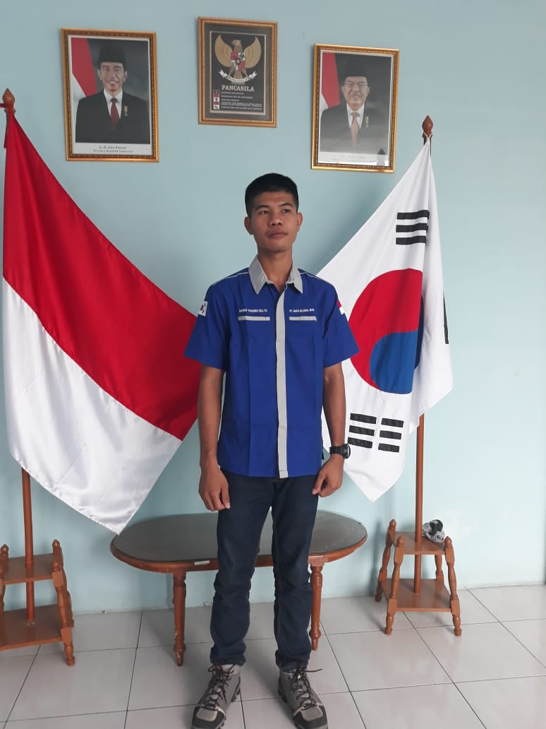
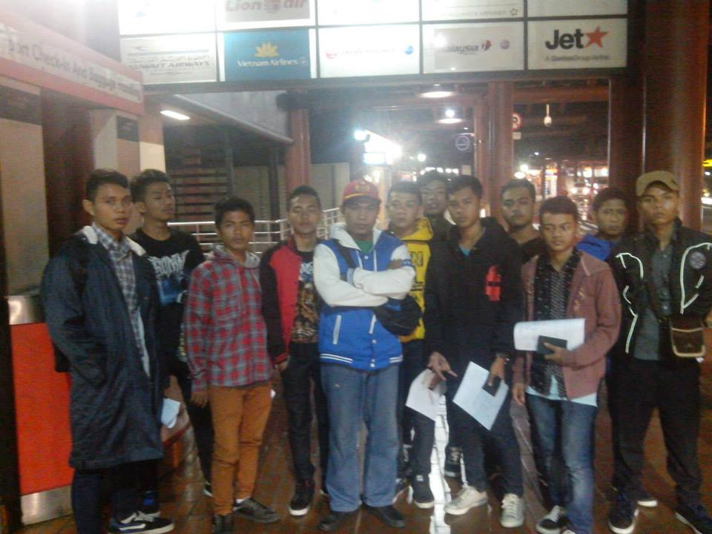
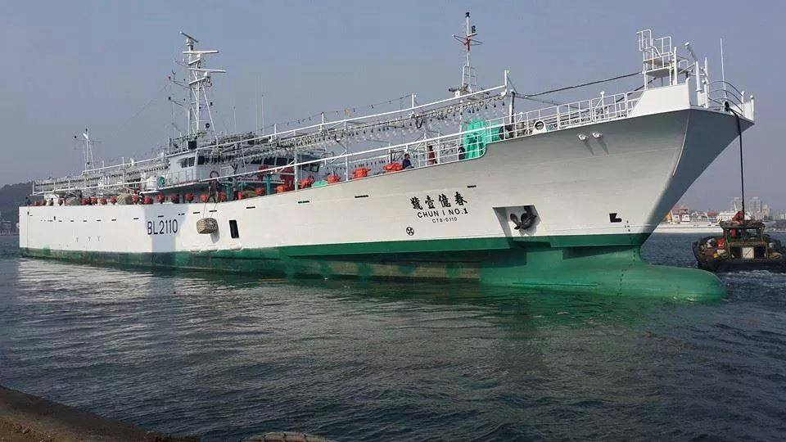
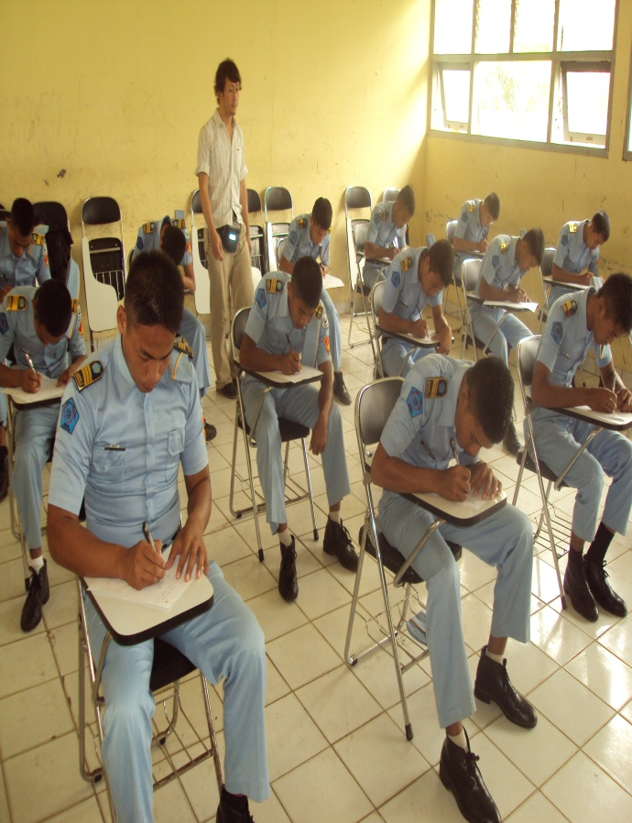
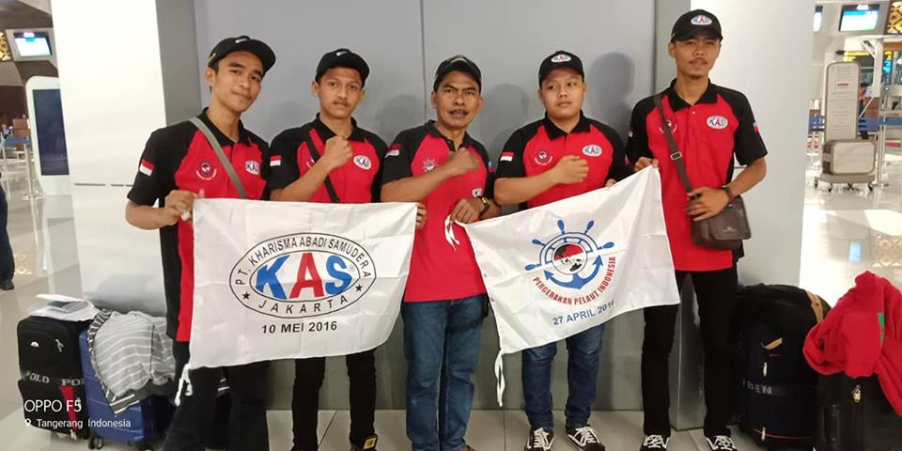

Slide 12
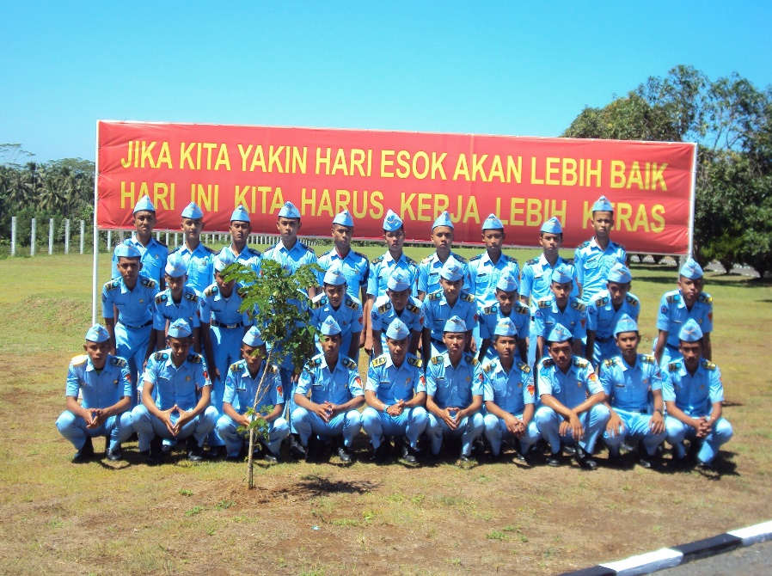
THANK YOU
MAILING ADRESS
Cipeundeuy Street, Surade
Sukabumi Region
West Java – Indonesia 43179
Phone/Fax : 0226 6492119
Email : smknsurade@ymail.com
Website : smkn1surade.sch.id
Blog : http://nauticasmkn1surade.blogspot.com

